Slide 1

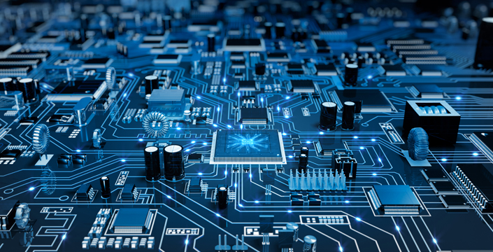
Embedded programing course
IoT-TLU Laboratory

Slide 2
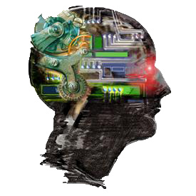
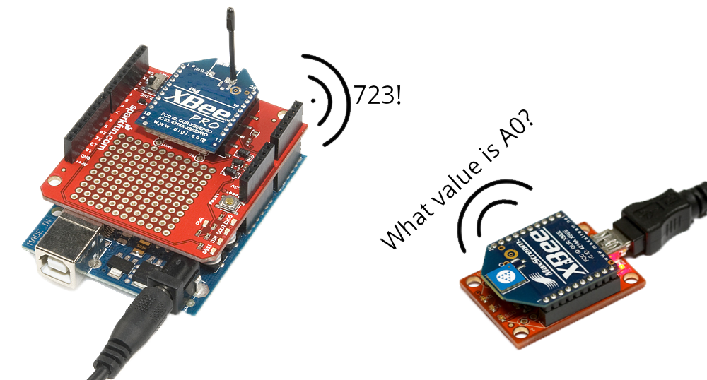
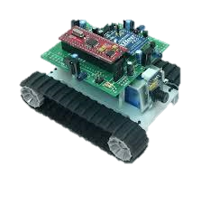
Introduction of Embedded systems
Introduction
Applications
History
Characteristics
Architecture & Design
Typical Development KITs

Slide 3
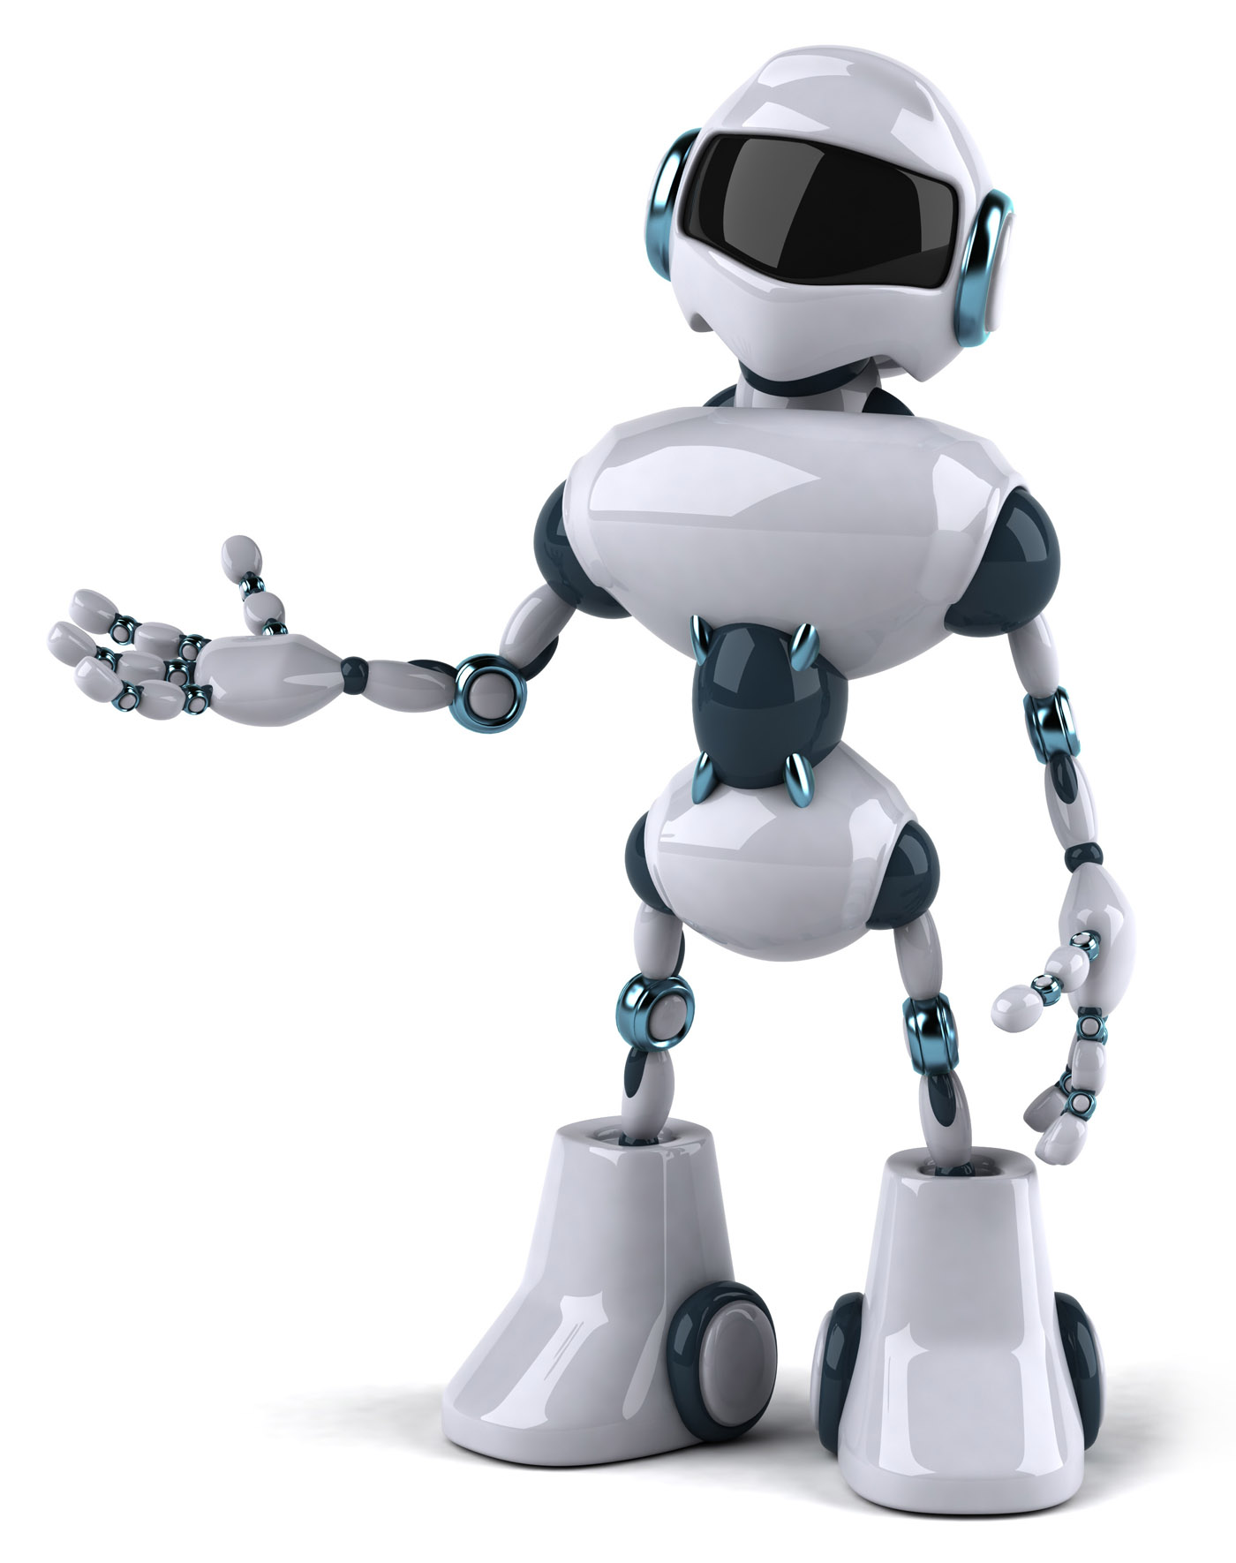
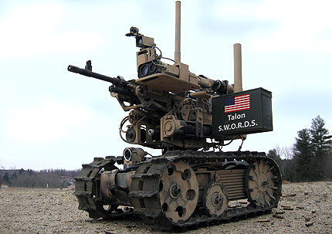
What is an embedded system?

Slide 4

How about this one?

Slide 5
Definitions
An embedded system is one that has computer hardware with software embedded in it as one of its components.
We can define an embedded system as “A microprocessor based system that does not look like a computer”.
We can say that it is “A combination of computer hardware and software, and perhaps additional mechanical or other parts, designed to perform a dedicated function. In some cases, embedded systems are part of a larger system or product, as is the case of an antilock braking system in a car ”.

Slide 6
Definitions
An embedded system is a special-purpose computer system designed to perform certain dedicated functions. It is usually embedded as part of a complete device including hardware and mechanical parts.

Slide 7
Significance
Due to their compact size, low cost and simple design aspects made embedded systems very popular and encroached into human lives and have become indispensable. They are found everywhere from kitchen ware to space craft.

Slide 8

Introduction of Embedded systems
Introduction
Applications
History
Characteristics
Architecture & Design
Typical Development KITs

Slide 9
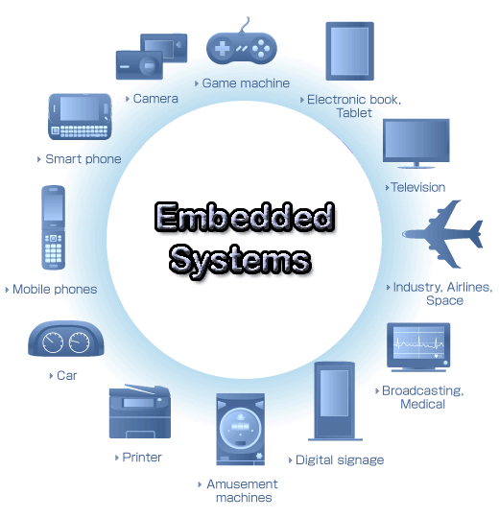
Embedded System Applications

Slide 10
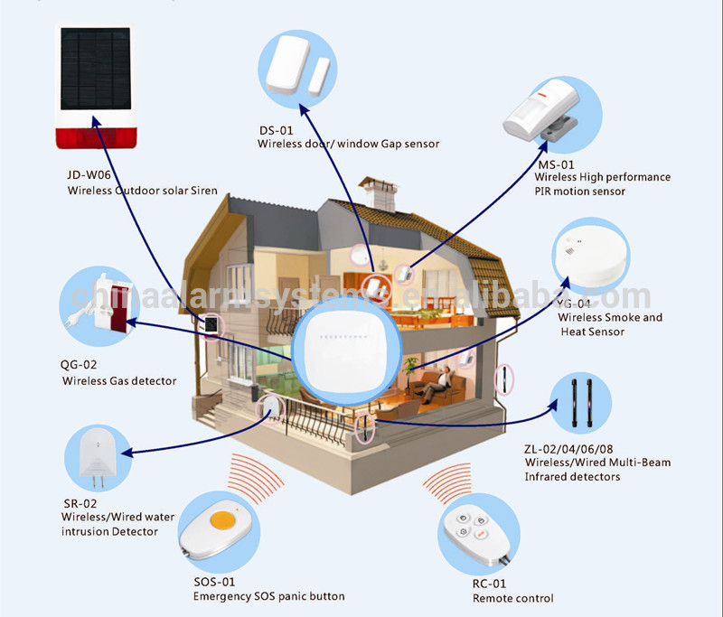
Smart home

Slide 11
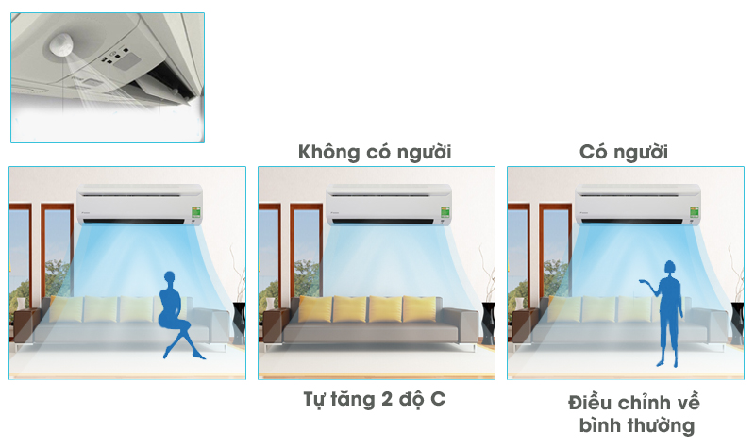
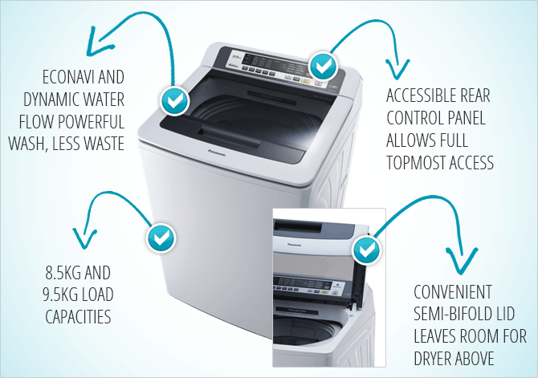
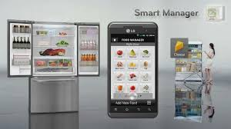
In kitchen

Slide 12
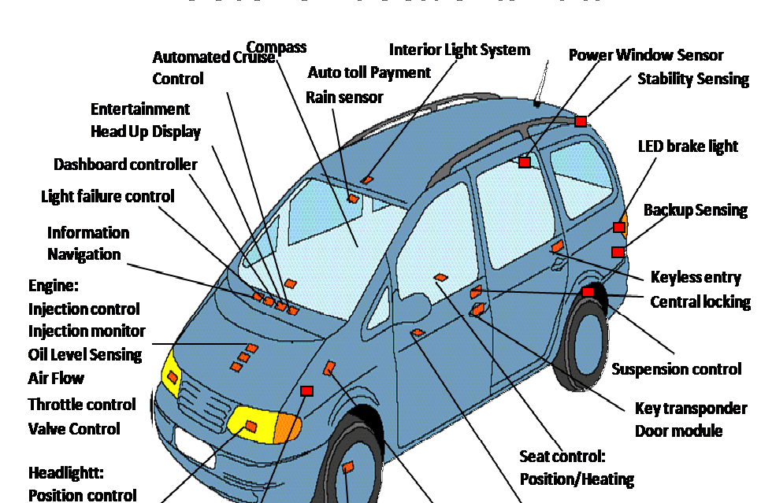
Smart car

Slide 13
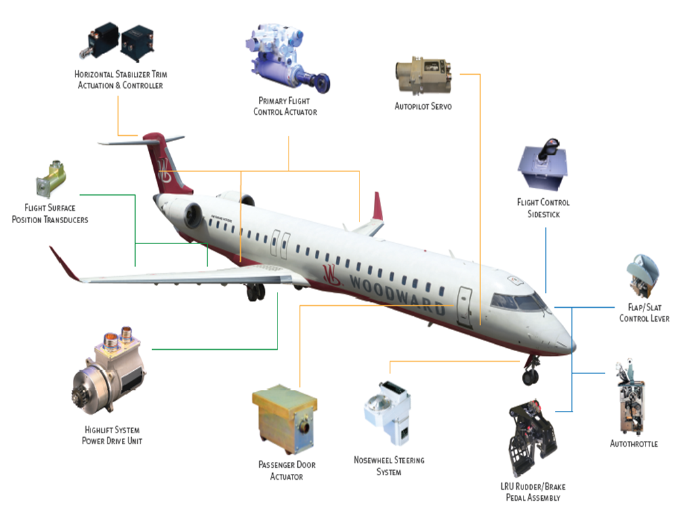
On plane

Slide 14
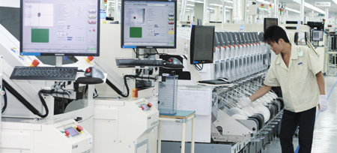
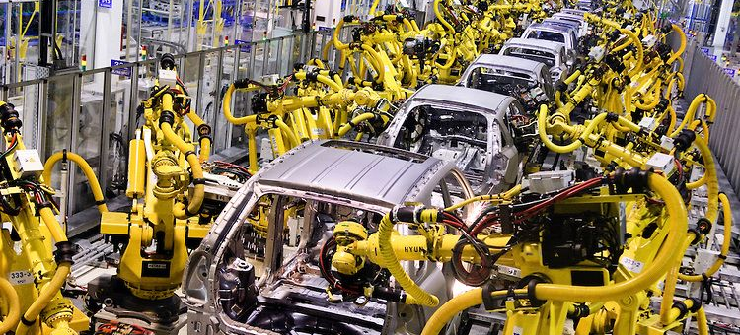
In factory

Slide 15
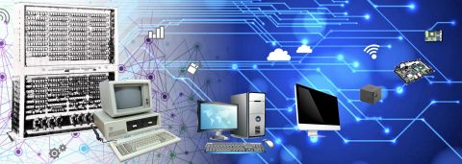
Introduction of Embedded systems
Introduction
Applications
History
Characteristics
Architecture & Design
Typical Development KITs
PIC16C505

Slide 16
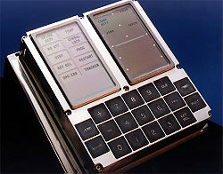
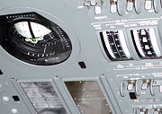
History
In the earliest years of computers in 1930 – 40s, computers were sometimes dedicated to a single purpose task.
One of the first recognizably modern embedded system was the Apollo Guidance Computer, developed by Charles Stark Draper at the MIT Instrumentation Laboratory.

Slide 17
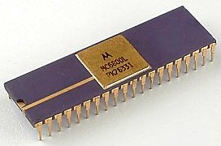
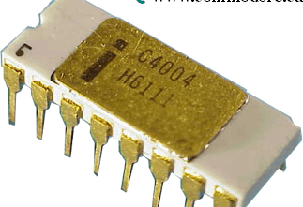
History
Since these early applications in the 1960s, embedded systems have come down in price and there has been a dramatic rise in processing power and functionality. The first microprocessor for example, the Intel 4004 was designed for calculators and other small systems but still required many external memory and support chips.

Slide 18
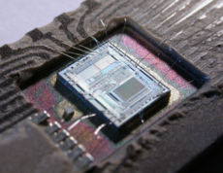
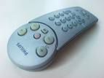
History
By the mid-1980s, most of the common previously external system components had been integrated into the same chip as the processor and this modern form of the microcontroller allowed an even more widespread use, which by the end of the decade were the norm rather than the exception for almost all electronics devices.

Slide 19
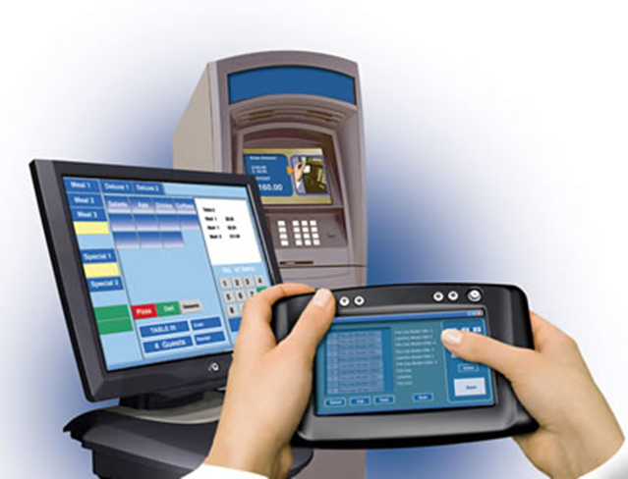
Introduction of Embedded systems
Introduction
Applications
History
Characteristics
Architecture & Design
Typical Development KITs

Slide 20
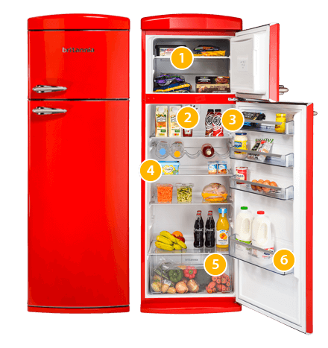
Characteristics
Special-purpose
Typically, is designed to execute a single program, repeatedly
It used to be single-purpose
Now, multi-functioned, but single-purpose
Tactic and Strategy

Slide 21
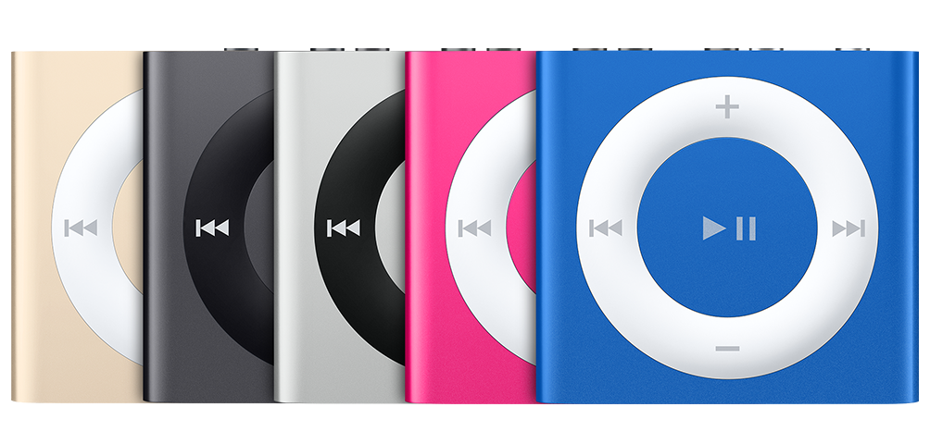
Characteristics
Tightly constrained
Low cost
Simple systems
Fewer components based
Performs functions fast enough
Minimum power

Slide 22
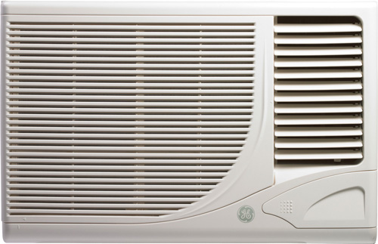
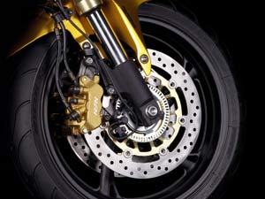
Characteristics
Reactive and real-time
Reactive: Continually reacts to external events
Real-time: Must compute certain results in real-time

Slide 23
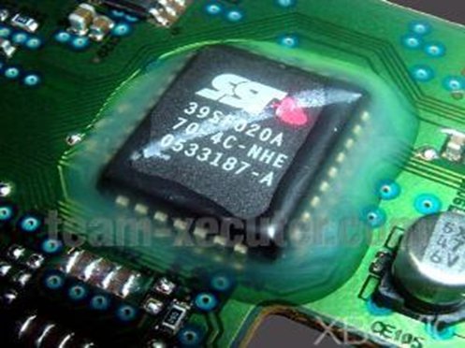
Characteristics
Hardware and software co-exist
The software written for embedded systems is often called firmware
Is stored in read-only memory or Flash memory chips rather than a disk drive

Slide 24
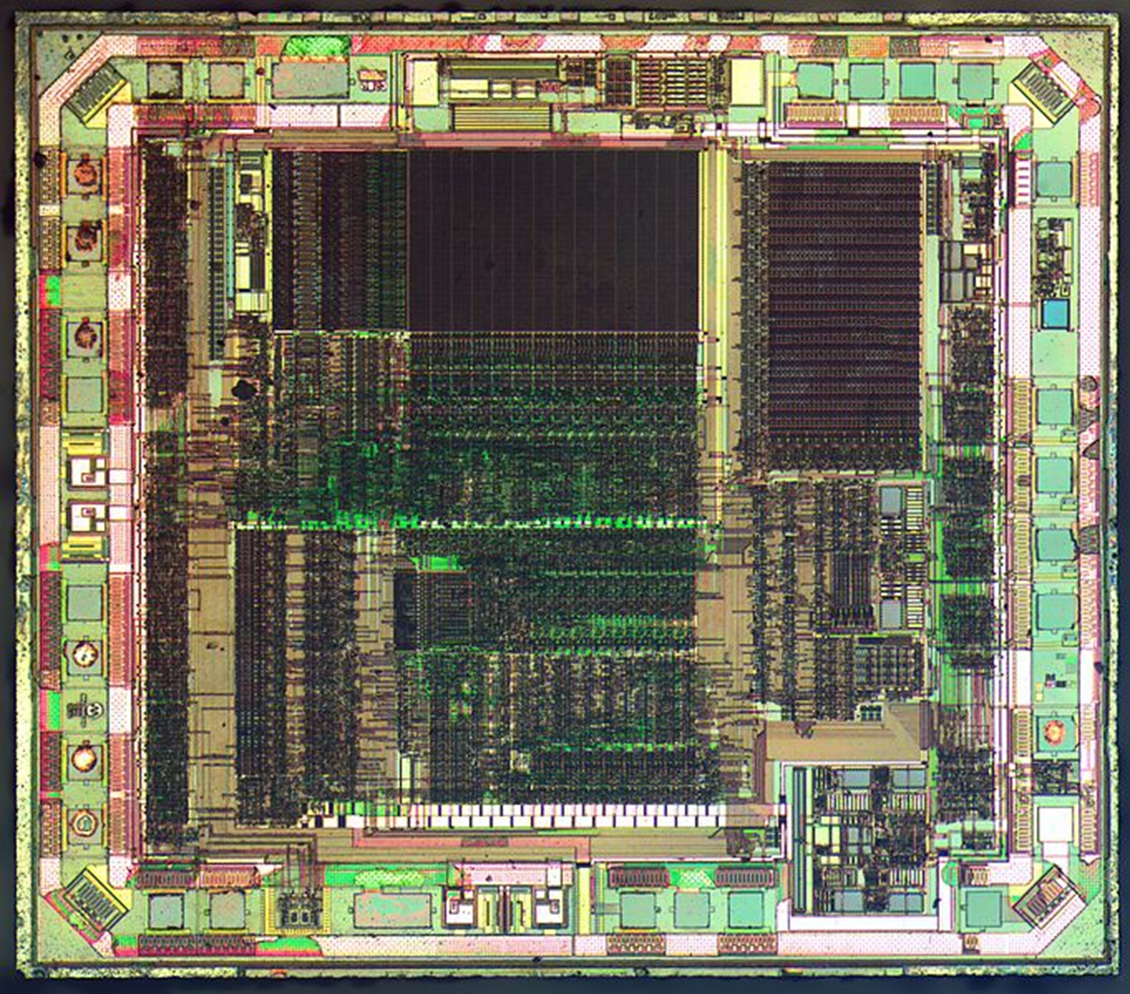
Introduction of Embedded systems
Introduction
Applications
History
Characteristics
Architecture & Design
Typical Development KITs

Slide 25
Block Description of an Embedded System
SENSORS
CONTROL UNIT
ACTUATOR

Slide 26
Block Description of an Embedded System

Slide 27
Why a microcontroller?
A microcontroller is a single silicon chip with memory and all Input/Output peripherals on it. Hence a microcontroller is also popularly known as a single chip computer. Normally, a single microcomputer has the following features:
Arithmetic and logic unit
Memory for storing program
EEPROM for nonvolatile data storage
RAM for storing variables and special function registers
Input/output ports

Slide 28
Why a microcontroller ?
Timers and counters
Analog to digital converter
Circuits for reset, power up, serial programming, debugging
Instruction decoder and a timing and control unit
Serial communication port
So, its no wonder to say that the microcontroller is the most sought after device for designing an efficient embedded system.

Slide 29
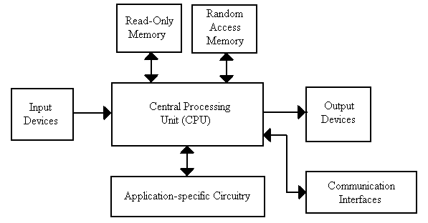
What is inside an embedded system?
There are various building blocks of the hardware of an embedded system:
Central Processing Unit (CPU)
Memory (ROM & RAM)
Input Devices
Output Devices
Communication interfaces
Application specific circuitry

Slide 30
Languages for Programming Embedded Systems
Assembly language was the pioneer for programming embedded systems till recently. Nowadays there are many more languages to program these systems. Some of the languages are C, C++, Ada, Forth, Python and Java together with its new enhancement J2ME.
The majority of software for embedded systems is still done in C language. Recent survey indicates that approximately 45% of the embedded software is still being done in C language.
C++ is also increasing its presence in embedded systems. As C++ is based on C language, thus providing programmer the object oriented methodologies to reap the benefits of such an approach.

Slide 31
Languages for Programming Embedded Systems
C is very close to assembly programming and it allows very easy access to underlying hardware. A huge number of high quality compilers and debugging tools are available for the C language.
Though C++ is theoretically more efficient than C, but some of its compilers have bugs due to the huge size of the language. These compilers may cause a buggy execution.

Slide 32
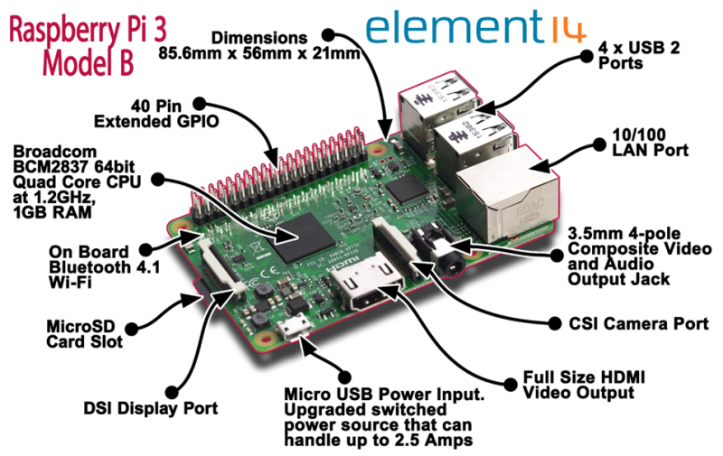
Introduction of Embedded systems
Introduction
Applications
History
Characteristics
Architecture & Design
Typical Development KITs

Slide 33
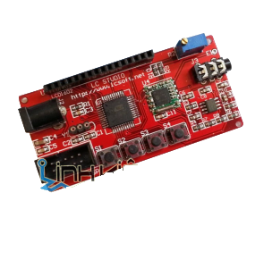
Typical Development KITs
AVR ATmega16
Maximum Clock Frequency: 16 MHz
Program Memory Size: 16 kB
RAM: 1 kB SRAM
ROM: 512B EEPROM
ADC Resolution: 10 bit
Operating Supply Voltage: 4.5 V to 5.5 V
Number of I/Os: 32 I/O
Number of Timers/Counters: 3 Timer
Number of ADC Channels: 8 Channel

Slide 34
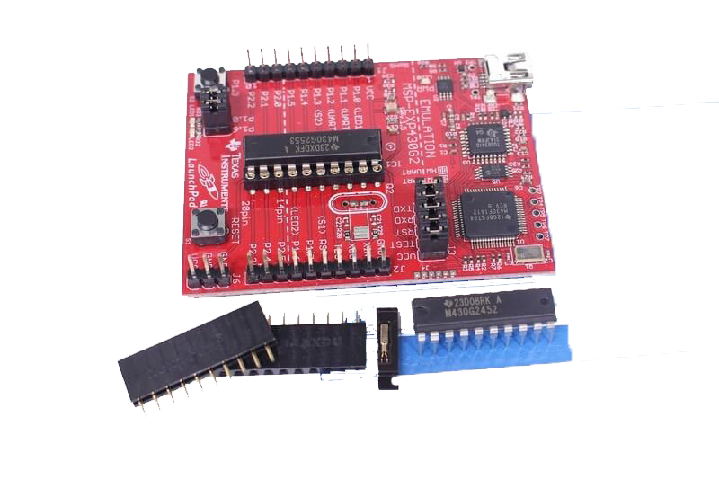
Typical Development KITs
MSP430
16kB Flash Memory
512B RAM
14 interruptible GPIOs (capacitive sense-capable)
16-bit timers
8ch 10-bit ADC, Comparator
Serial Communication (USCI – I2C, SPI & UART)

Slide 35
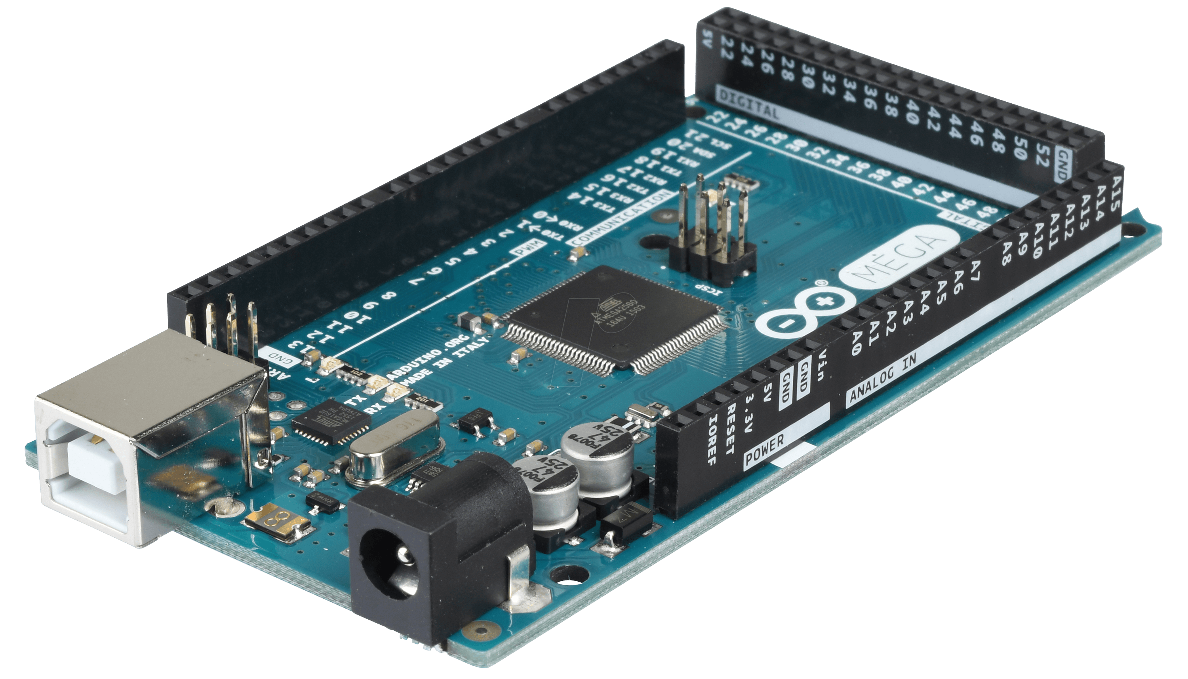
Typical Development KITs
Arduino MEGA 2560 R3
Operating Voltage: 5V
Input Voltage (recommended): 7-12V
Input Voltage (limit): 6-20V
Digital I/O Pins: 54 (of which 15 provide PWM output)
Analog Input Pins: 16
DC Current per I/O Pin: 20 mA
DC Current for 3.3V Pin : 50 mA
Flash Memory: 256 KB of which 8 KB used by bootloader
SRAM: 8 KB
EEPROM:4 KB
Clock Speed:16 MHz
LED_BUILTIN:13

Slide 36
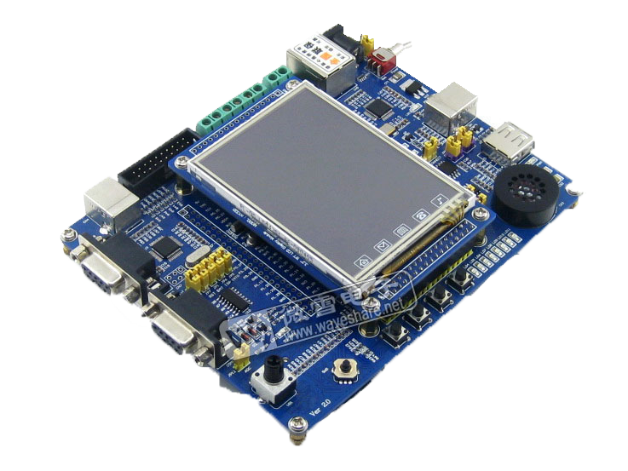
Typical Development KITs
ARM KIT
RISC 32-bit microcontroller
Clock frequency: 100MHz
Communication: RS232, RJ45, RS485, I2C, MMC/SD
LCD 3.2 inch TFT 320 x 240
ADC Resolution: 10 bit
Operating Supply Voltage: 4.5 V to 5.5 V

Slide 37
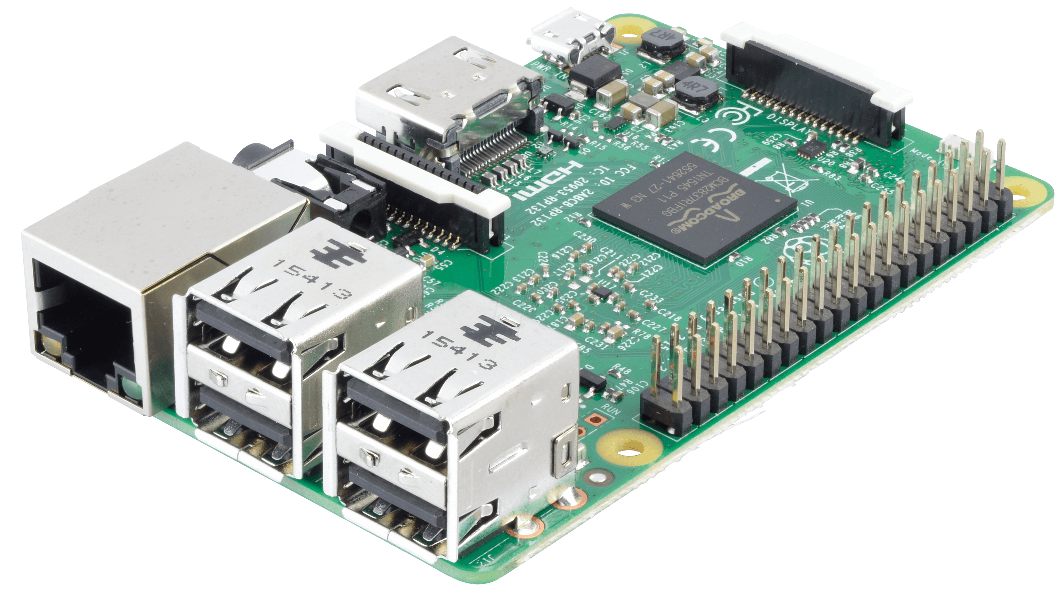
Typical Development KITs
Raspberry PI 3 Model B:
Quad Core 1.2GHz Broadcom BCM2837 64bit CPU
1GB RAM
BCM43438 wireless LAN and Bluetooth Low Energy (BLE) on board
40-pin extended GPIO
4 USB 2 ports,
4 Pole stereo output and composite video port
Full size HDMI
CSI camera port for connecting a Raspberry Pi camera
DSI display port for connecting a Raspberry Pi touchscreen display
Micro SD port for loading your operating system and storing data
Upgraded switched Micro USB power source up to 2.5A

Slide 38
QUESTIONS?

